Slide 1
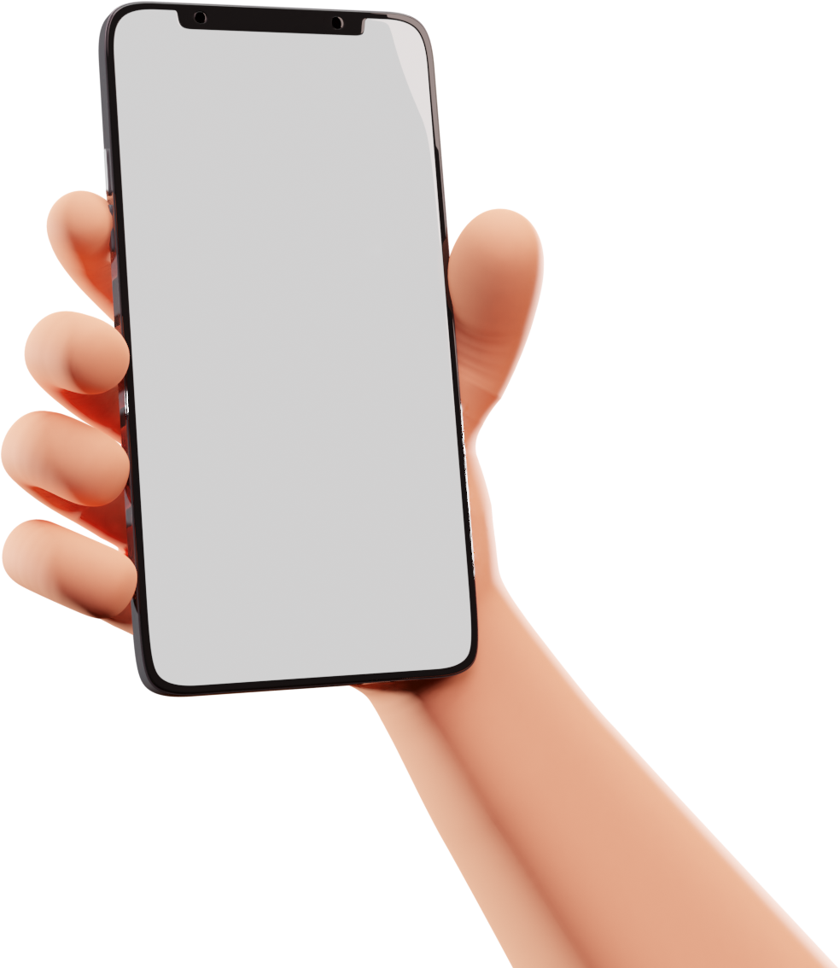
Chat app using Flutter and Firebase DB.
Innovaters++
Hemanshu Patil
Nikhil Sonawane
Saurabh Jare

Slide 2
Introduction
Flutter is Google’s portable UI toolkit for crafting beautiful, natively compiled applications for mobile, web, and desktop from a single codebase. Flutter works with existing code, is used by developers and organizations around the world, and is free and open source.
Flutter is different than most other options for building mobile apps because it doesn’t rely on web browser technology nor the set of widgets that ship with each device. Instead, Flutter uses its own high-performance rendering engine to draw widgets.

Slide 3
Advantages
Cross-platform Operations: Apps made with flutter can be operated on both the platform (iOS and Android). There is no need for reconfigurations and redesigning.
Less Need of Developers: This can be advantageous for the companies, as they require a smaller number of developers and the app can also work on both the platforms.
Less Development Cost: Since there are a smaller number of developers needed, the cost incurred for the development of the app also reduces.
Time Constraint: The time required to launch the app into the market, also reduces as only a single app has to be made, which would work independently of the platform.
Powerful Design: Flutter mobile framework is the latest in the market, and this helps to create a very powerful app design with minimum efforts.

Slide 4
What is Firebase ?
The Firebase Realtime Database is a cloud-hosted NoSQL database that lets organizations store and sync data in real time across all of their users' devices. This makes it easy to build apps that are always up to date, even when users are offline.
Firebase is a product of Google which helps developers to build, manage, and grow their apps easily. It helps developers to build their apps faster and in a more secure way. No programming is required on the firebase side which makes it easy to use its features more efficiently. It provides services to android, ios, web, and unity. It provides cloud storage. It uses NoSQL for the database for the storage of data.

Slide 5
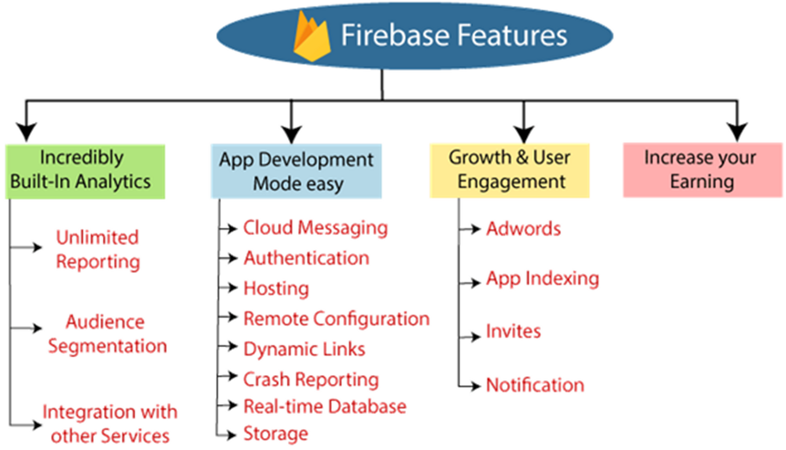
Features of Firebase Database

Slide 6
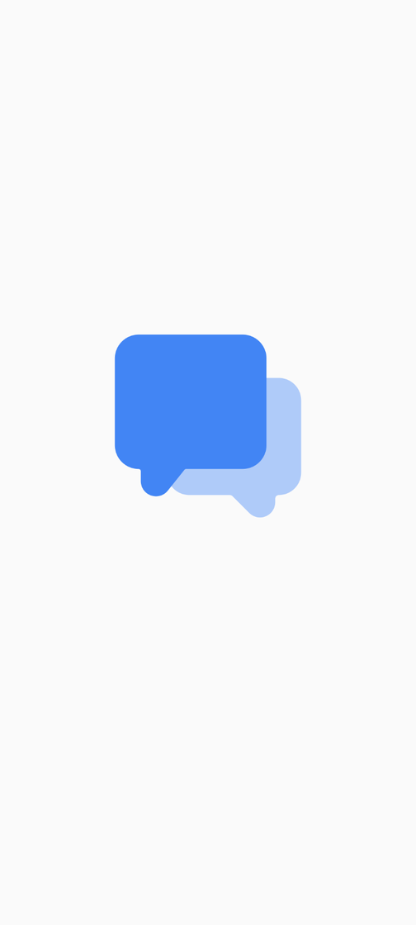
Features of our App
Splash Screen
First screen when opening an app.
Displays brand logo or identity.
Shows loading progress.
Sets initial user impression.
Bridges to main interface.

Slide 7
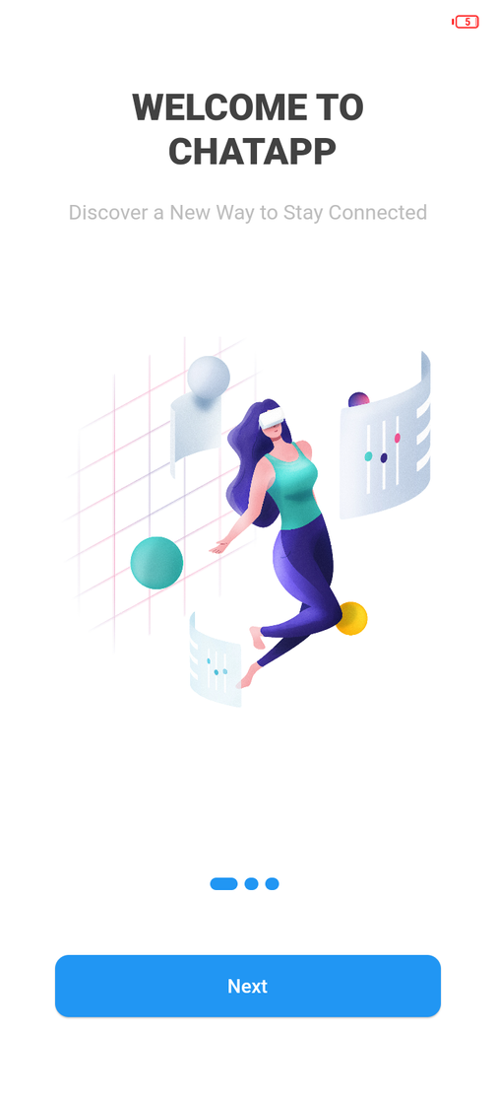
Boarding Screen
Welcomes users initially.
Offers essential info or tips.
Sets up user preferences.
Guides users on using the app.
Transitions to the main interface.

Slide 8
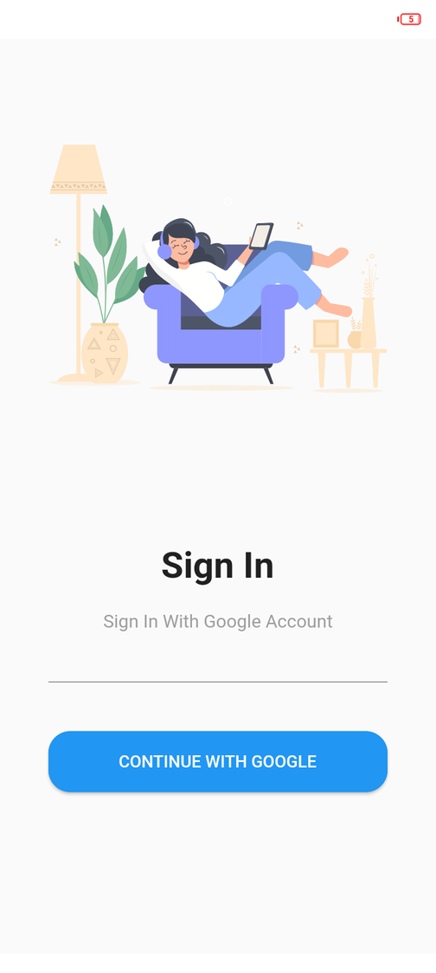
Login Page
Requests user credentials.
Offers secure access.
Verifies user identity.
Grants entry to the app/system.
Allows personalized experiences.

Slide 9
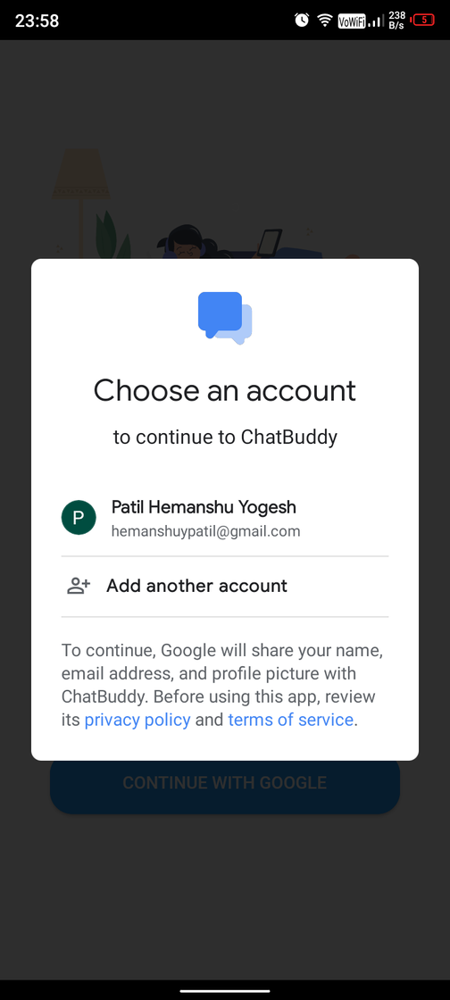
Account Screen For Google Sign
Requests Google credentials.
Provides options for account selection.
Requires user consent for permissions.
Displays account details for confirmation.
Allows access to linked Google services.

Slide 10
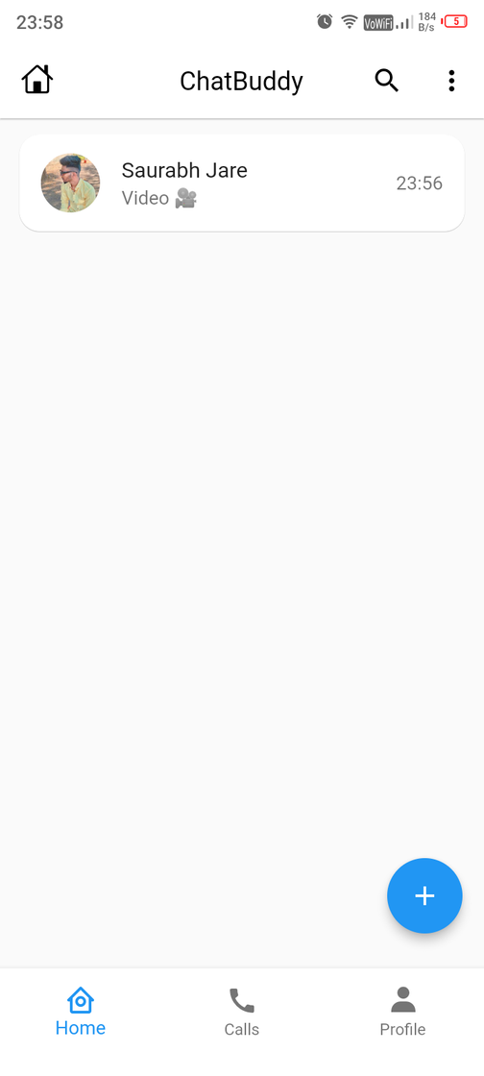
Home Screen
Serves as app's main interface.
Displays essential content or options.
Navigates to various app sections.
Often customizable to user preferences.
Central hub for app functionality.

Slide 11
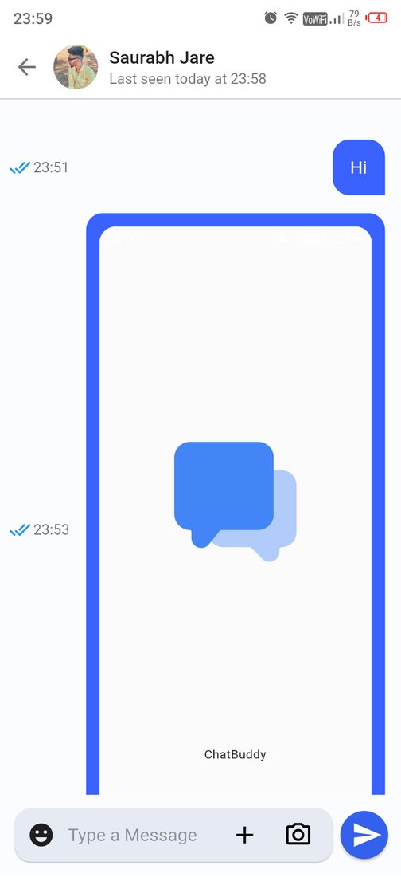
Chat Screen
Shows conversation threads.
Displays messages sent and received.
Supports multimedia sharing.
Offers options for interaction (e.g., emojis).
Facilitates real-time communication.

Slide 12
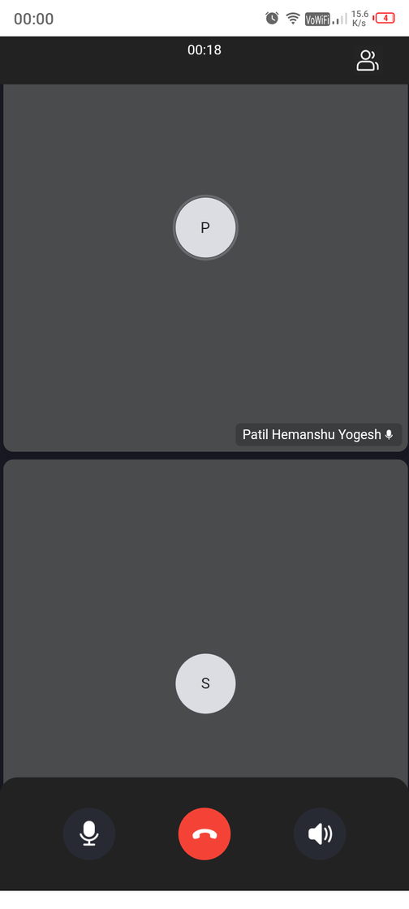
Voice Call Screen
Initiates and ends calls.
Displays caller's information.
Shows call duration and options.
Provides mute and speaker controls.
Allows for seamless conversation.

Slide 13
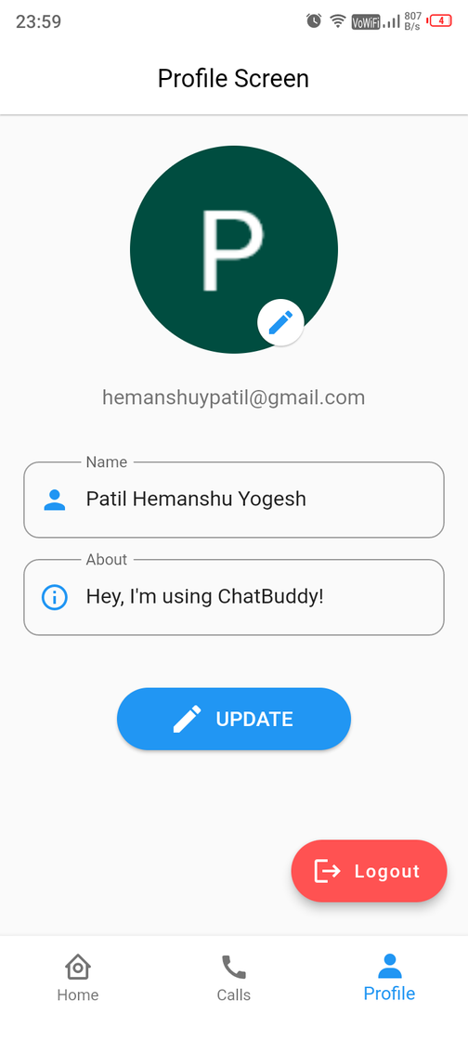
Profile Screen
Displays user information.
Allows profile customization.
Shows account settings.
Provides options for updates.
Manages preferences and personal details.

Slide 14
Thank You

